Slide 2
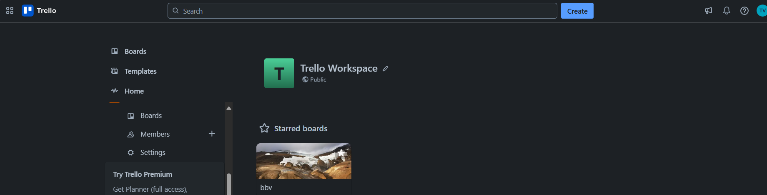



FUNCTIONS IN THE TRELLO SYSTEM
bbv Software Services AG | 21/07/2025

Slide 3
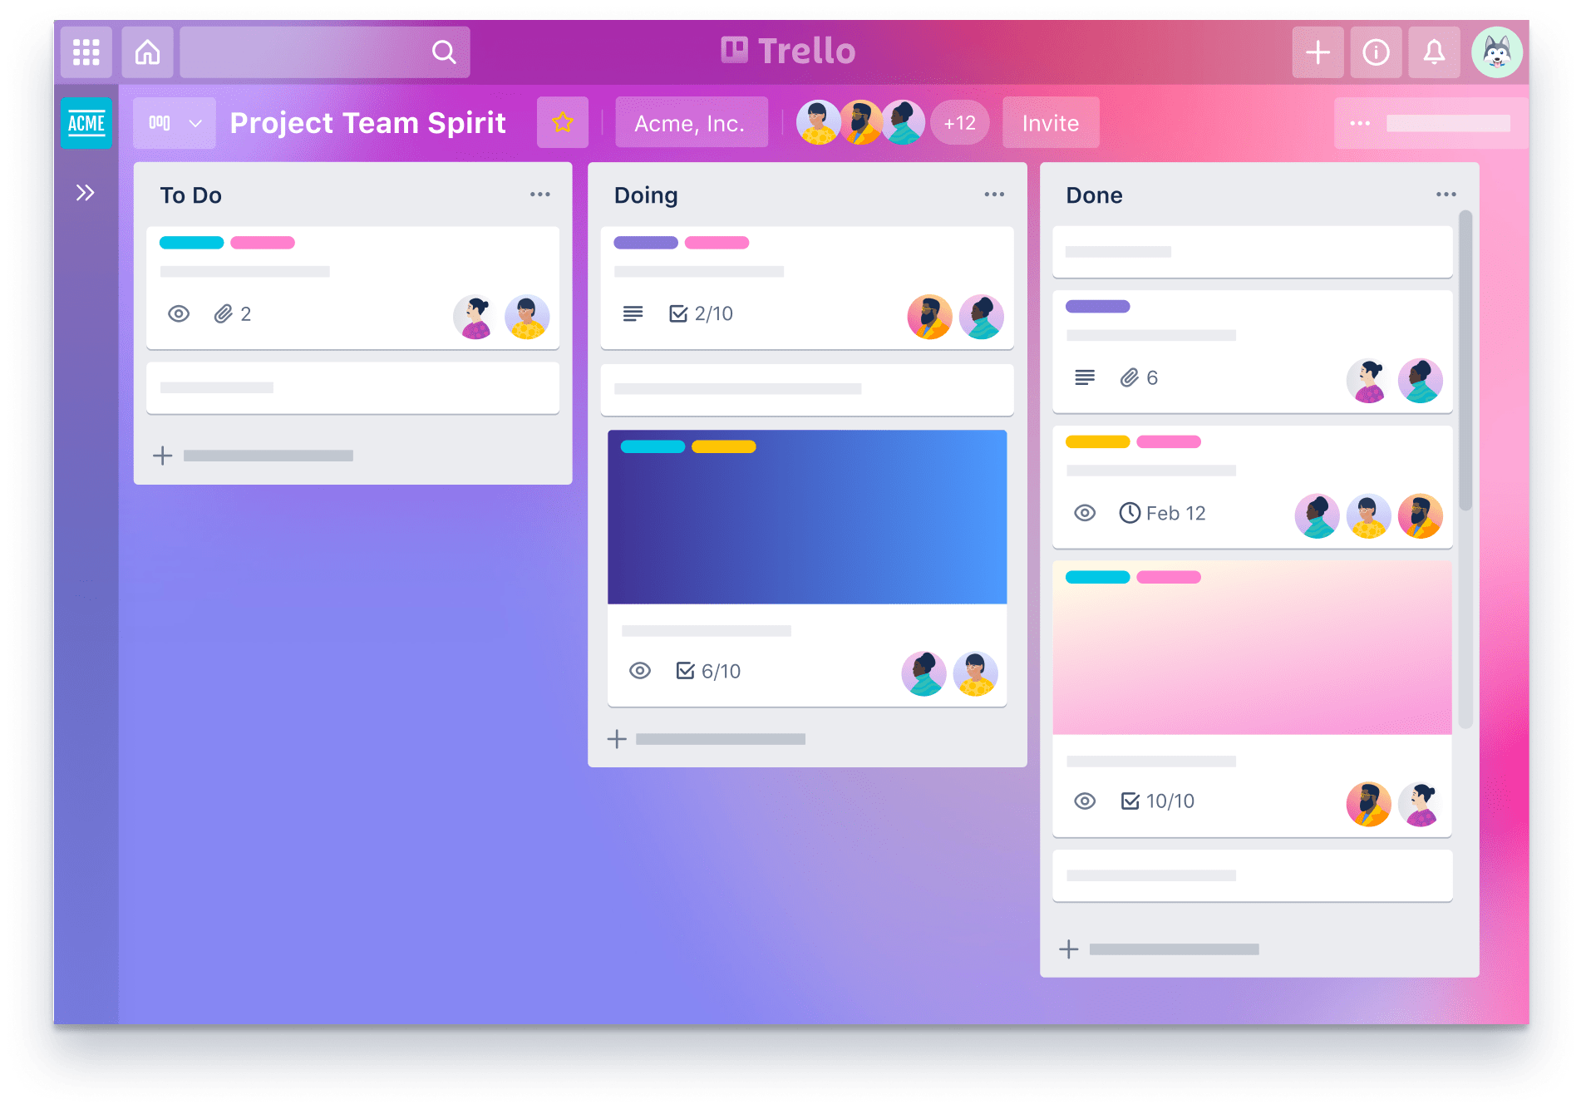
Agenda
Introduction to Functionality and UI in the Trello System
Entities in Trello System
Q&A

Slide 4
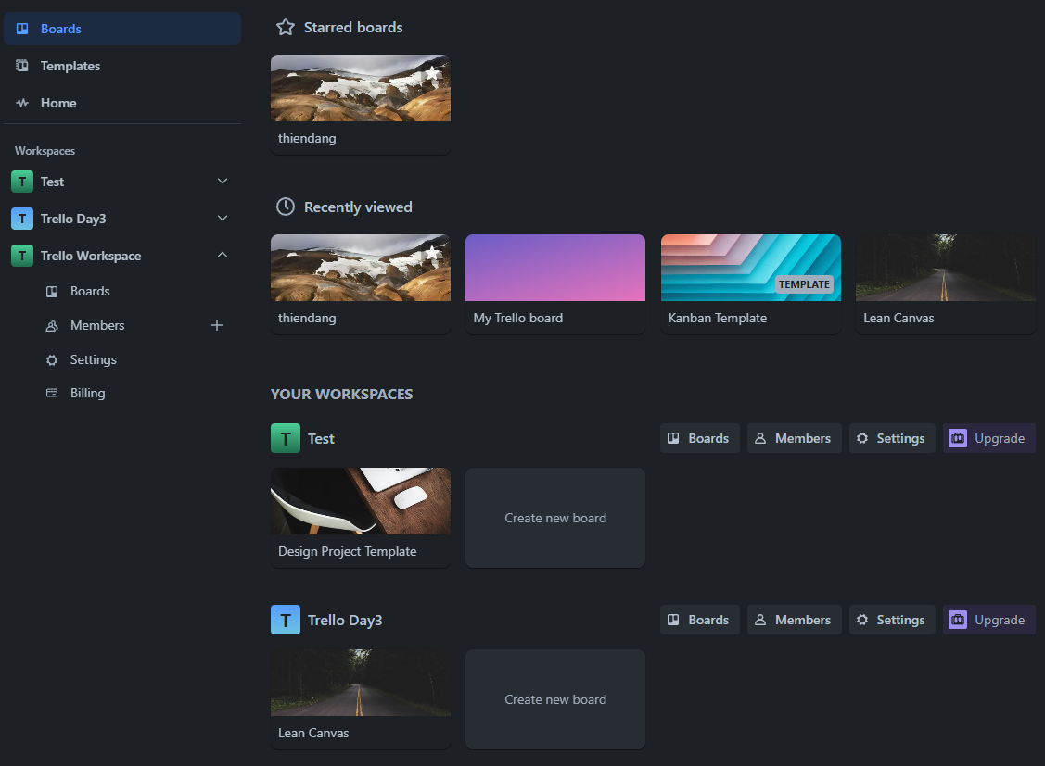
BOARDS TAB IN TRELLO SYSTEM
Board
Workspace
Notes:
-- Get 4 recently viewed boards by user(id=1)
SELECT TOP 4 b.Id, b.BoardName, b.BackgroundUrl
FROM Boards b
JOIN BoardUsers bu ON bu.BoardId = b.Id
JOIN Users u ON u.Id = bu.UserId
WHERE bu.UserId = 1
ORDER BY bu.AccessedAt DESC;
-- Homepage: Workspace, Member
-- Get all workspace that User(id=1) is member
SELECT w.Id, w.WorkspaceName
FROM Workspaces w
JOIN Members m ON m.OwnerId = w.Id
JOIN OwnerTypes ot ON m.OwnerTypeId = ot.Id
JOIN Users u ON u.Id = m.UserId
WHERE ot.OwnerTypeValue = 'Workspace' AND u.Id = 1;
-- Get list all board that User(i=1) is member for each Workspace
SELECT b.Id AS BoardId, b.BoardName AS BoardName, w.WorkspaceName AS WorkspaceName, b.BackgroundUrl
FROM Boards b
JOIN Members m ON m.OwnerId = b.Id
JOIN OwnerTypes ot ON ot.Id = m.OwnerTypeId
JOIN Workspaces w ON b.WorkspaceId = w.Id
JOIN Users u ON m.UserId = u.Id
WHERE u.Id = 1 AND ot.OwnerTypeValue = 'Board’
-- Homepage: Board Starred
-- Get the all starred boards by the user(id=8). (Slide 4)
SELECT b.Id, b.BoardName
FROM Boards b
JOIN BoardUsers bu ON bu.BoardId = b.Id
JOIN Users u ON bu.UserId = u.Id
WHERE u.Id = 8 AND b.IsStar = 1

Slide 5
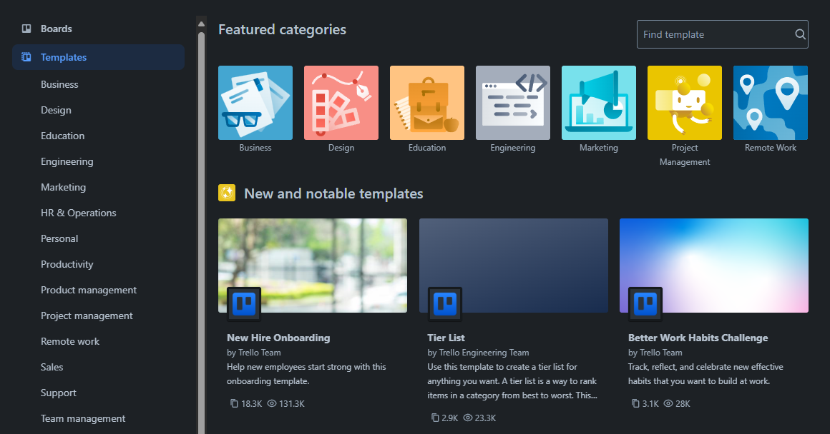
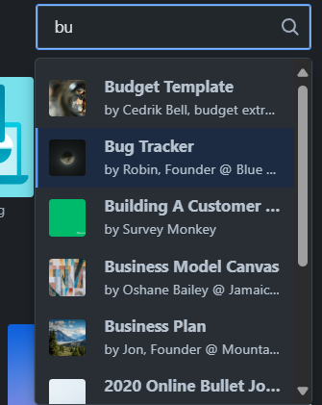
TEMPLATE TAB IN TRELLO SYSTEM
TemplateCategory
Template
Notes:
-- Template
-- Get all template categories. (Slide 5)
SELECT TOP 7 Id, TemplateCategoryName , IconUrl
FROM TemplateCategories;
-- Get top 3 most viewed templates. (Slide 5)
SELECT TOP 3 t.Id, t.Title, t.TemplateDescription, t.Copied, t.Viewed, t.BackgroundUrl
FROM Templates t
ORDER BY Viewed DESC
-- Search templates by keyword in title. (Slide 5)
SELECT t.Id, t.Title, t.BackgroundUrl , u.Username
FROM Templates as t
JOIN Boards b ON b.Id = t.BoardId
JOIN Users u ON u.Id = t.CreatedBy
WHERE Title LIKE '%B%';

Slide 6

TEMPLATE TAB IN TRELLO SYSTEM
TemplateCategory
Notes:
-- Get list templates in a specific category (e.g., 'VP Marketing'). (Slide 6)
SELECT TOP 3 t.Id, t.Title, t.TemplateDescription, t.Copied, t.Viewed, t.BackgroundUrl
FROM Templates t
JOIN TemplateCategories tc ON tc.Id = t.TemplateCategoryId
WHERE TC.TemplateCategoryName ='VP Marketing'

Slide 7
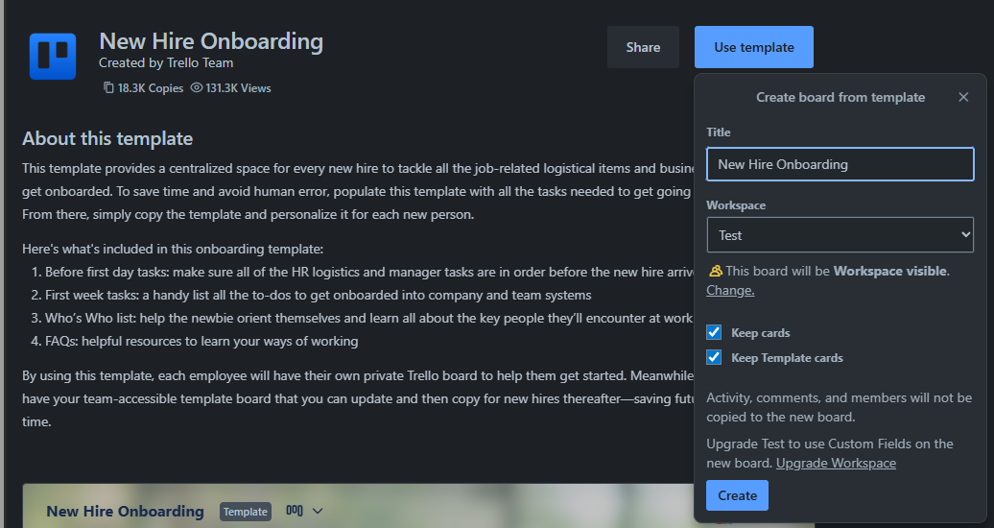
TEMPLATE IN TRELLO SYSTEM
Template
Board
Notes:
-- Get information templates(category = 'VP Marketing', id=22)
SELECT t.Id, t.Title, u.PictureUrl, t.TemplateDescription, t.Copied, t.Viewed, t.BackgroundUrl
FROM Templates t
JOIN TemplateCategories tc ON tc.Id = t.TemplateCategoryId
JOIN Users u ON u.Id = t.CreatedBy
WHERE tc.TemplateCategoryName ='VP Marketing' AND t.Id ='22'
-- Get information templates from board (use templates)
SELECT t.Id, t.Title, t.TemplateDescription, t.Copied, t.Viewed, b.BackgroundUrl, b.BoardName
FROM Templates t
JOIN Boards b ON b.id = t.BoardId
WHERE t.Id = 1;

Slide 8
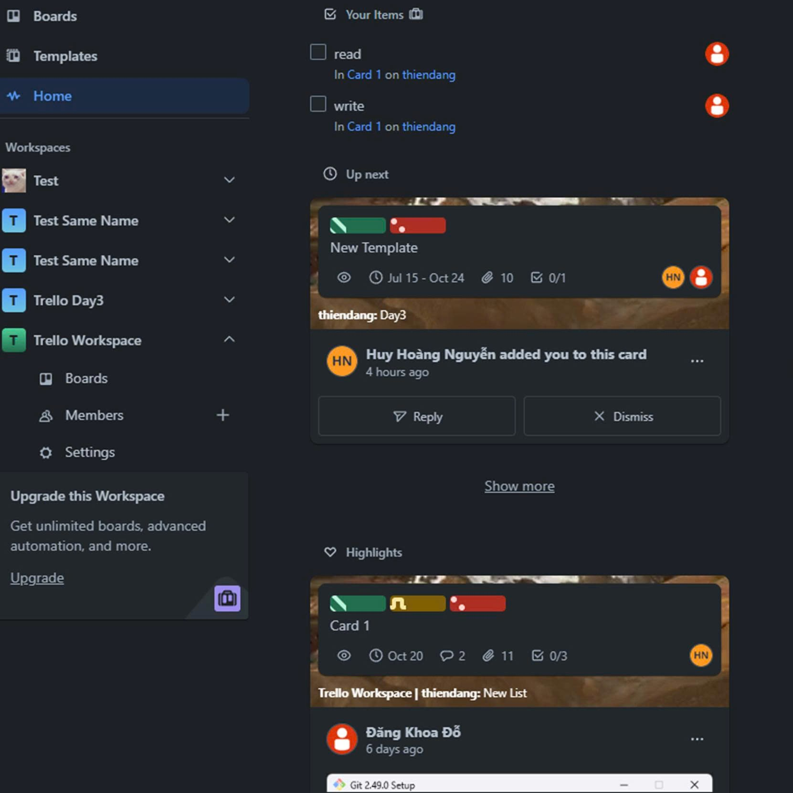
HOME TAB IN TRELLO SYSTEM
Checklist item
Activity
TemplateCategory
Template
Comment
Notes:
-- list all checklist items assigned to the user with status set to false. (Slide 8)
SELECT
cli.CheckListItemName AS checklist_item_name,
cli.CheckListItemStatus AS checklist_item_status,
ca.Title AS card_title,
bo.BoardName AS board_name,
us.PictureUrl
FROM CheckListItems cli
JOIN CheckLists cl ON cl.Id = cli.CheckListId
JOIN Cards ca ON ca.Id = cl.CardId
JOIN Stages st ON st.Id = ca.StageId
JOIN Boards bo ON bo.Id = st.BoardId
JOIN Members me ON me.Id = cli.MemberId
JOIN Users us ON us.Id = me.UserId
WHERE cli.CheckListItemStatus = 0 AND me.UserId = 1;
List all Activities of cards that are currently assigned to the member.
List all Comment of cards that are currently assigned to the member.

Slide 9
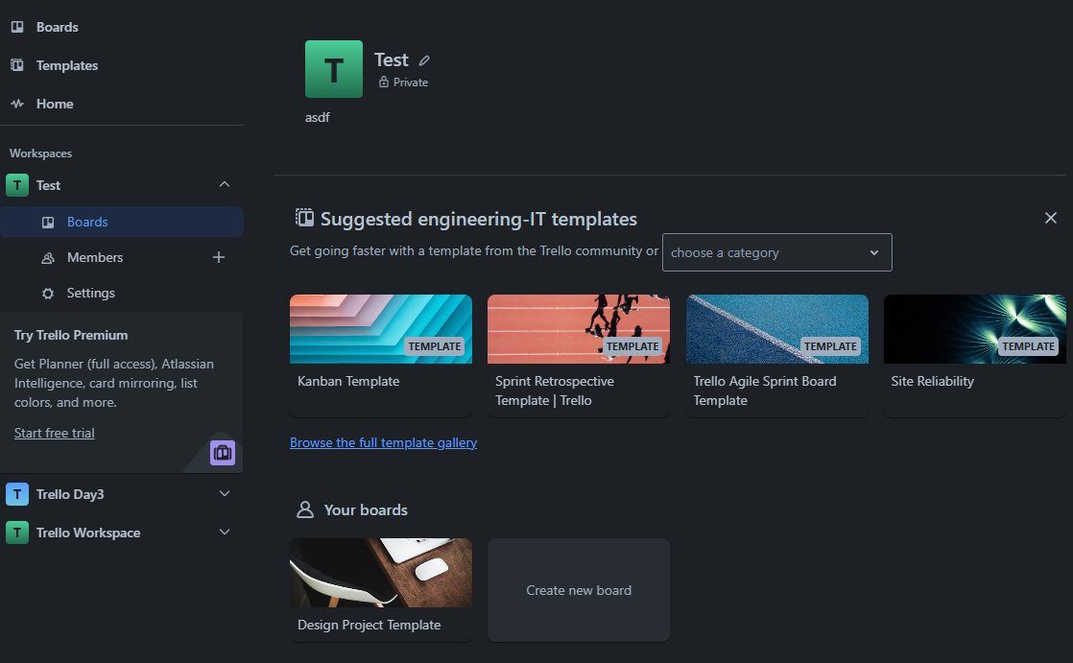
WORKSPACE IN TRELLO SYSTEM
Click here
Template
Board
Notes:
-- Get top 4 suggested Boards Template for each Teamplate category have highest view
SELECT TOP 4 b.Id, b.BoardName, b.BackgroundUrl
FROM Boards b
JOIN Templates t ON t.BoardId = b.Id
JOIN TemplateCategories tc ON t.TemplateCategoryId = tc.Id
WHERE tc.TemplateCategoryName = 'Financial Analyst'
ORDER BY
t.Viewed DESC
-- Get Boards that user(id=1) is a member in workspace(i=2)
SELECT b.Id, b.BoardName, b.BackgroundUrl
FROM Boards b
JOIN Members m ON m.OwnerId = b.Id
JOIN OwnerTypes ot ON ot.Id = m.OwnerTypeId
JOIN Workspaces w ON w.Id = b.WorkspaceId
JOIN Users u ON u.Id = m.UserId
WHERE ot.OwnerTypeValue = 'Board' AND u.Id = 1 AND w.Id = 1

Slide 10

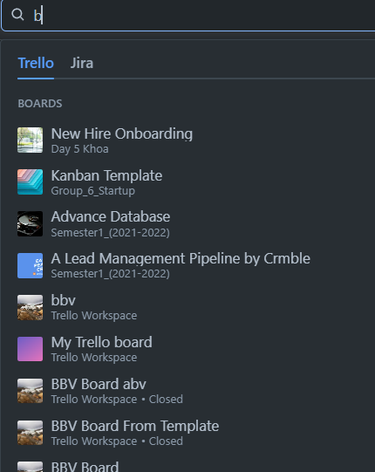
USERBOARDRECENTLYVIEW
IN TRELLO SYSTEM
UserViewHistories
Notes:
-- Search boards by keyword in title.
SELECT b.BoardName
FROM Boards b
WHERE b.BoardName LIKE '%b%';

Slide 11
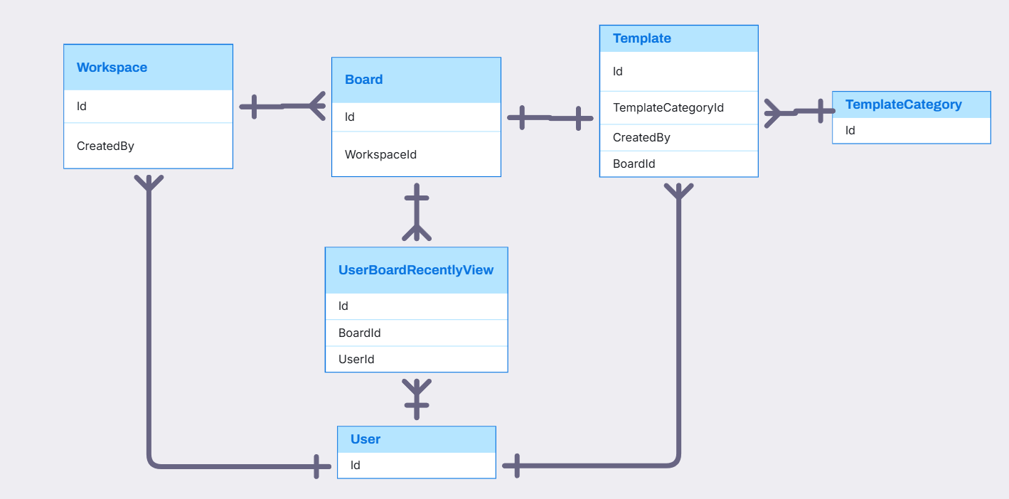
USER, WORKSPACE, BOARD, TEMPLATE, TEMPLATECATEGORY, USERBOARD RELATIONSHIP

Slide 12
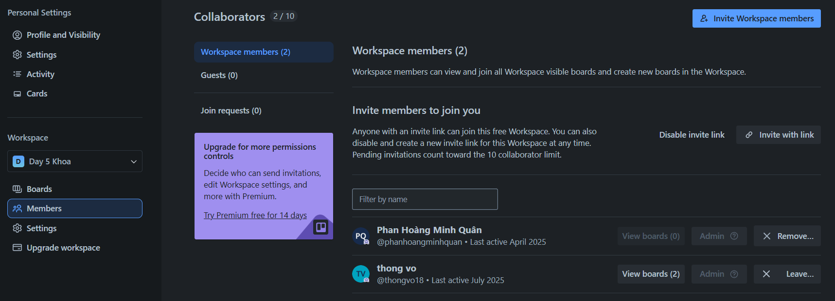
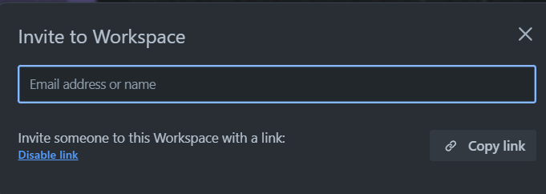
WORKSPACE IN TRELLO SYSTEM
ShareLink
Member
Permission
Notes:
-- Get all the members of workkspace(id=13) and with permission
WITH GetUserPermission AS
(SELECT m.UserId , m.PermissionId
FROM Members m
JOIN OwnerTypes ot ON ot.Id = m.OwnerTypeId
JOIN Workspaces w ON m.OwnerId = w.Id
WHERE ot.OwnerTypeValue = 'Workspace' AND w.Id = 13)
SELECT u.Id, u.Username,u.PictureUrl, u.LastActive, p.RolePermissionName
FROM Users u
JOIN GetUserPermission gup ON gup.UserId = u.Id
JOIN RolePermissions p ON p.Id = gup.PermissionId

Slide 13
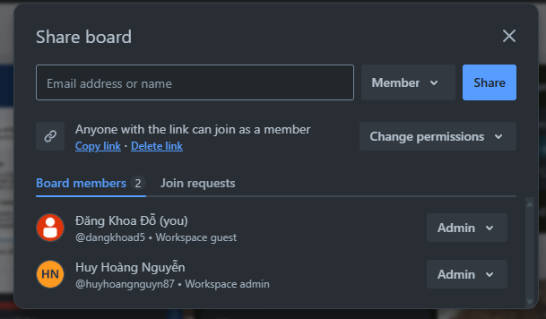
WORKSPACE IN TRELLO SYSTEM
ShareLink
Member
Permission
Notes:
-- Get sharelink of workspace(id=9)
SELECT sl.Token, sl.ShareLinkStatus
FROM ShareLinks sl
JOIN Workspaces w ON w.Id = sl.OwnerId
JOIN RolePermissions p ON sl.PermissionId = p.Id
WHERE w.Id = 9;
-- Get all members of the board(id=1) with permissions
SELECT m.Id, u.PictureUrl, u.Username, u.Email ,rp.RolePermissionName
FROM Members m
JOIN Boards b ON b.Id = m.OwnerId
JOIN OwnerTypes o ON o.Id = m.OwnerTypeId
JOIN RolePermissions rp ON rp.Id = m.PermissionId
JOIN Users u ON u.Id = m.UserId
WHERE o.OwnerTypeValue = 'Board' AND b.Id = 1;

Slide 14
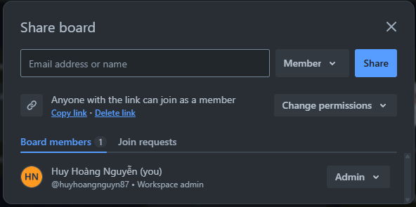
BOARD SHARE IN TRELLO SYSTEM
Add member to board with permission
Member Permission
Share link with permission

Slide 15
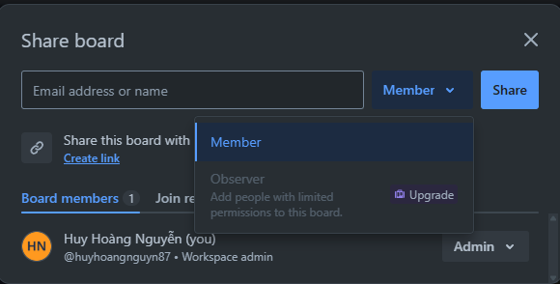
BOARD SHARE IN TRELLO SYSTEM
Permission code with admin, member, observer
Notes:
-- List all permission options can choose
SELECT RolePermissionName
FROM RolePermissions;

Slide 16
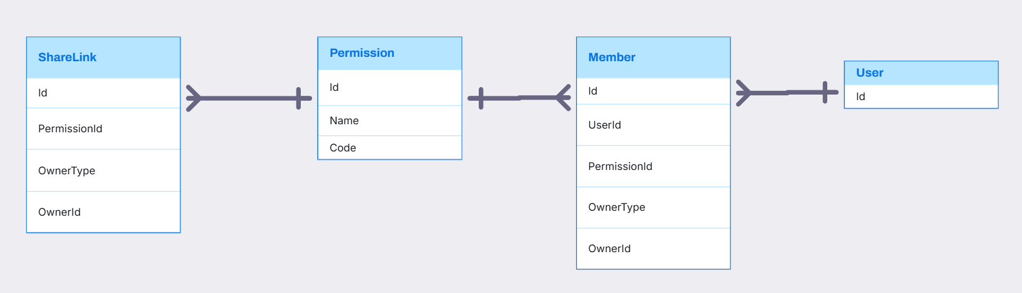
SHARELINK, PERMISSION, MEMBER RELATIONSHIP

Slide 17
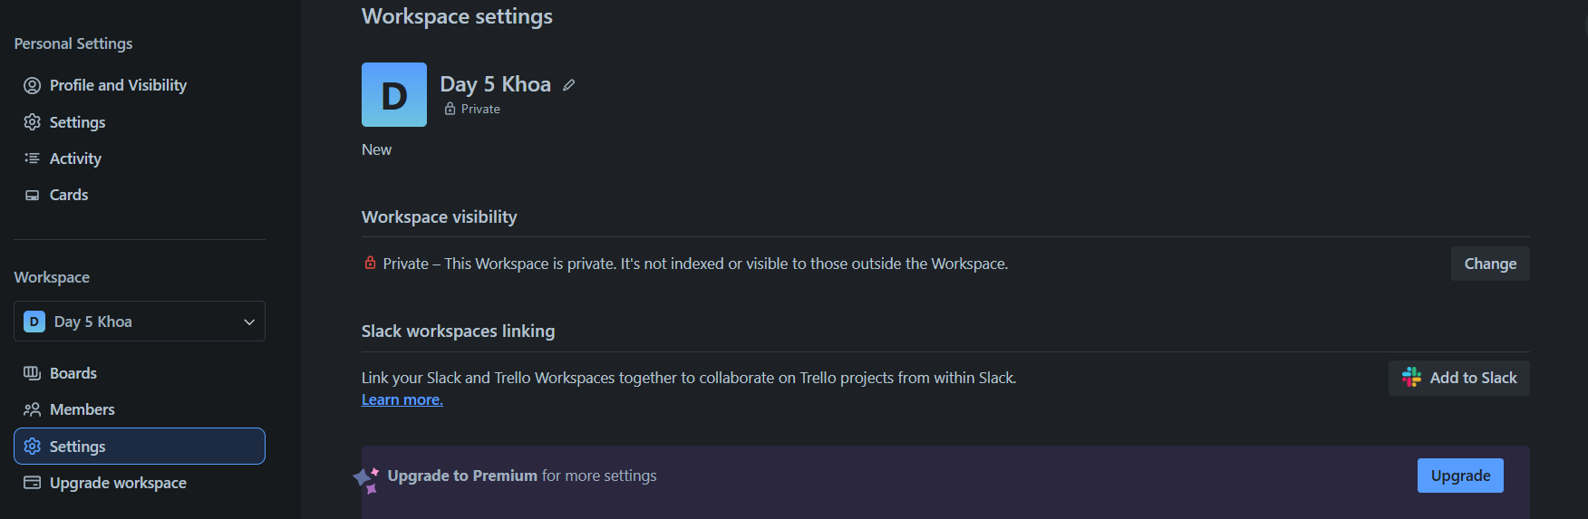
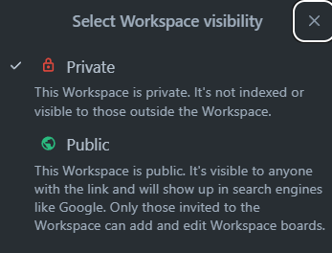
WORKSPACE SETTING IN TRELLO SYSTEM
SettingKey
SettingOption
SettingValue
Notes:
-- Get setting workspace(id=7) visibility(value=22, user=7)
SELECT w.Id, w.WorkspaceName, sk.KeyName, so.DisplayValue
FROM SettingKeys sk
JOIN SettingValues sv ON sv.SettingKeyId = sk.Id
JOIN OwnerTypes ot ON ot.Id = sk.OwnerTypeId
JOIN SettingOptions so ON so.Id = sv.SettingValue
JOIN Workspaces w ON w.Id = sv.OwnerId
JOIN Users u ON u.Id = w.CreatedBy
WHERE ot.OwnerTypeValue = 'Workspace' AND sk.KeyName = 'workspacevisibility' AND u.Id = 7 AND w.Id = 7;
-- Get SettingKeys and SettingOptions of this SettingKeys for Workspace
SELECT sk.KeyName, so.DisplayValue
FROM SettingKeys sk
JOIN SettingKeySettingOptions skso ON skso.SettingKeyId = sk.Id
JOIN SettingOptions so ON so.Id = skso.SettingOptionId
JOIN OwnerTypes ot ON ot.Id = sk.OwnerTypeId
WHERE ot.OwnerTypeValue = 'Workspace'
GROUP BY sk.KeyName, so.DisplayValue

Slide 18
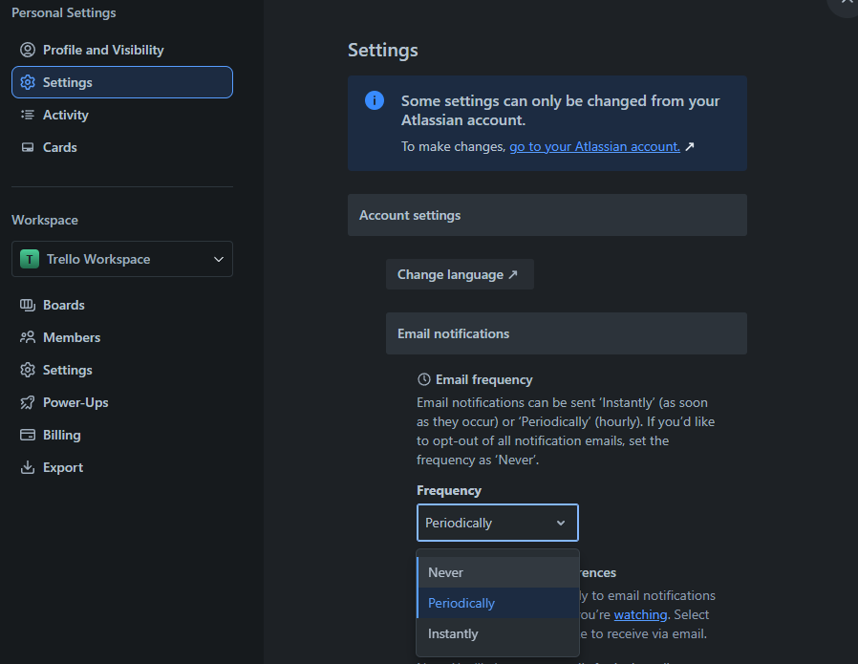
USER SETTING IN TRELLO SYSTEM
SettingKey
SettingValue
SettingOption
Notes:
-- Get all setting keys of user (id=1) with option value
SELECT sk.KeyName, sv.SettingValue AS SettingValueId, so.DisplayValue AS SettingOption, u.Id
FROM SettingKeys sk
JOIN SettingValues sv ON sv.SettingKeyId = sk.Id
JOIN OwnerTypes ot ON sk.OwnerTypeId = ot.Id
JOIN SettingOptions so ON so.Id = sv.SettingValue
JOIN Users u ON u.Id = sv.OwnerId
WHERE ot.OwnerTypeValue = 'User' AND u.Id = 6
ORDER BY sk.KeyName;

Slide 19
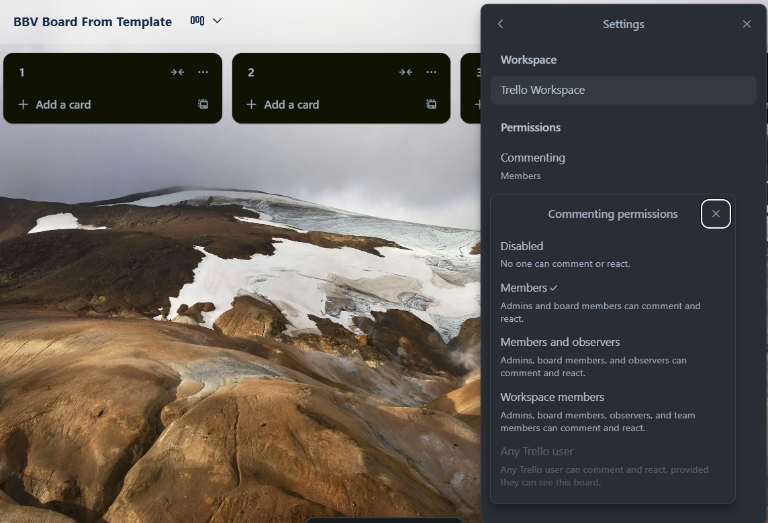
BOARD SETTING IN TRELLO SYSTEM
SettingKey
SettingValue
SettingOption

Slide 20
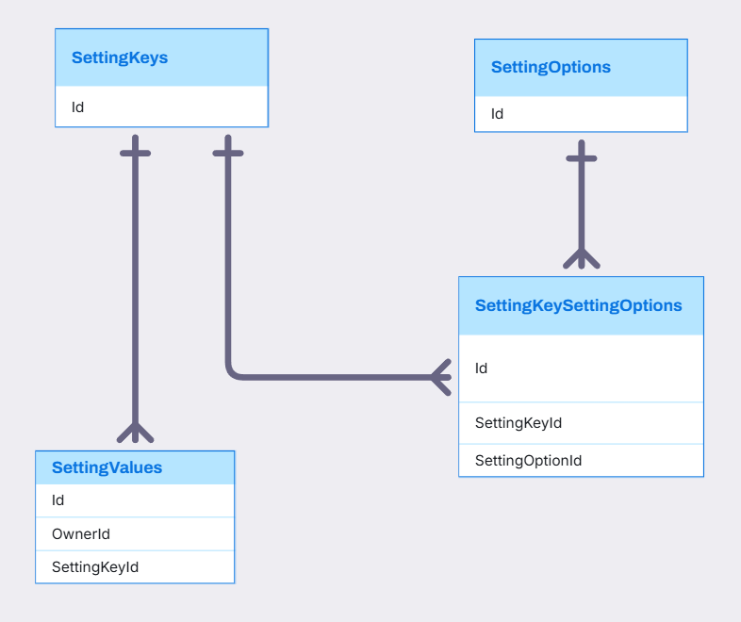
SETTINGKEY, SETTINGOPTION, SETTINGVALUE, SETTINGKEYSETTINGOPTION RELATIONSHIP

Slide 21
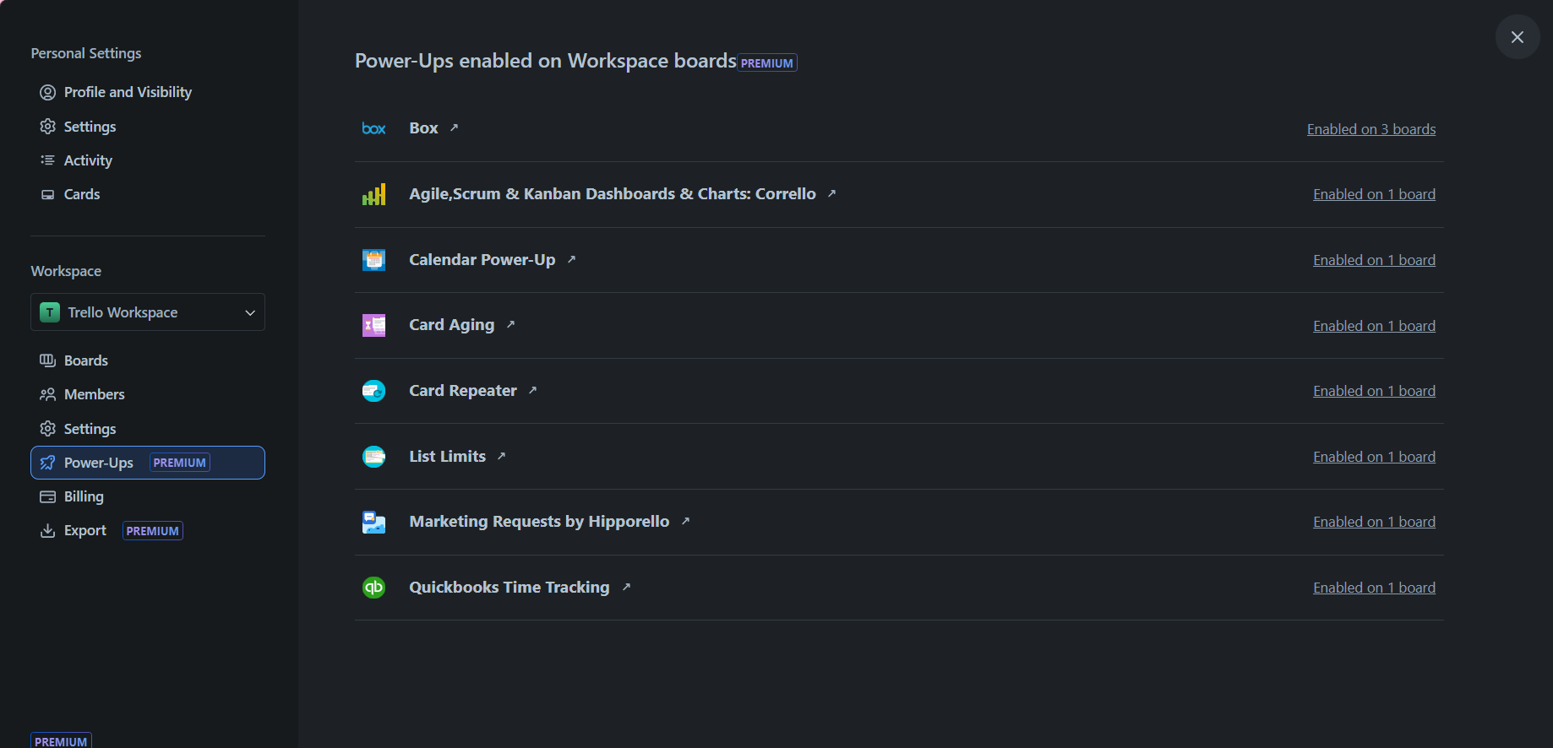
WORKSPACE IN TRELLO SYSTEM
Power-up
Notes:
-- Get name all power up of workspace(id=2)
SELECT pu.Id, pu.PowerUpName, pu.BackgroundUrl , pu.IsStaffPick
FROM PowerUps pu
JOIN BoardPowerUps bu ON bu.PowerUpId = pu.Id
JOIN Boards b ON b.Id = bu.BoardId
JOIN PowerUpCategories puc ON pu.PowerUpCategoryId = puc.Id
JOIN Workspaces w ON w.Id = b.Id
WHERE w.Id = 1 AND pu.IsStaffPick = 1;

Slide 22
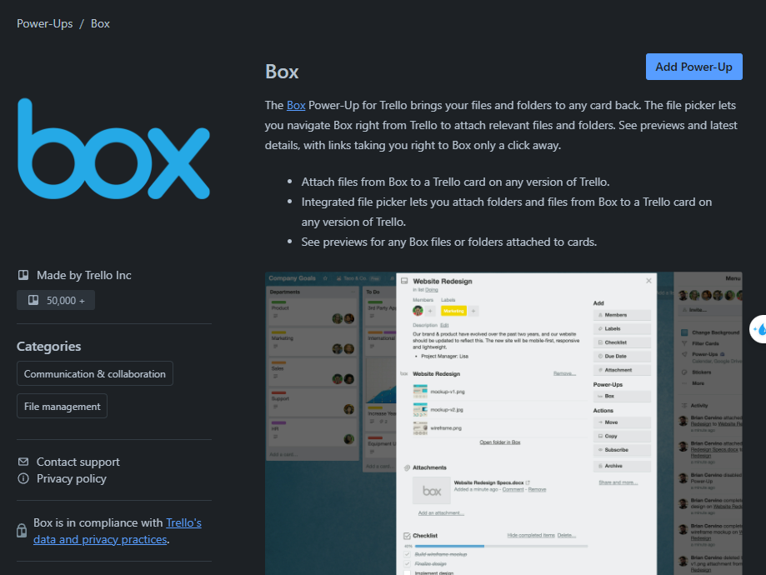
WORKSPACE IN TRELLO SYSTEM
Title
Description
AuthorName
PowerUpsCategory
Notes:
-- Get detail information power up(category=2)
SELECT pu.Id, pu.PowerUpName, pu.PowerUpDescription, pu.IconUrl, pu.AuthorName, pu.BackgroundUrl, puc.PowerUpCategoryName
FROM PowerUps pu
JOIN PowerUpCategories puc ON pu.PowerUpCategoryId = puc.Id
WHERE puc.id = 2

Slide 23
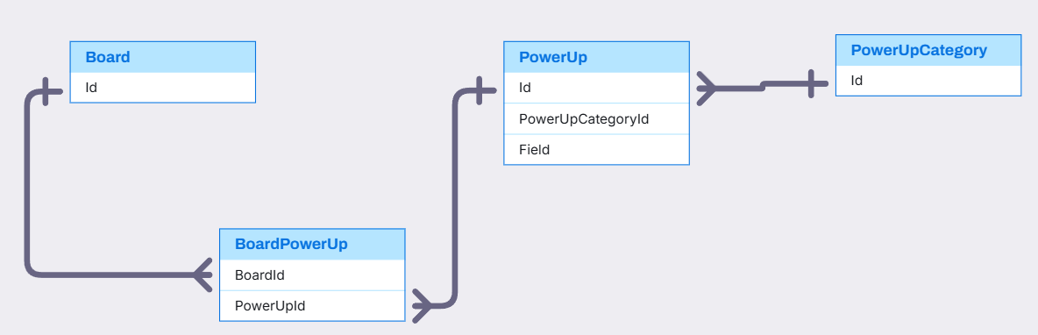
BOARD, POWERUP,POWERUPCATEGORY RELATIONSHIP
PowerUp,PowerUpCategory,Board(Quan)

Slide 24
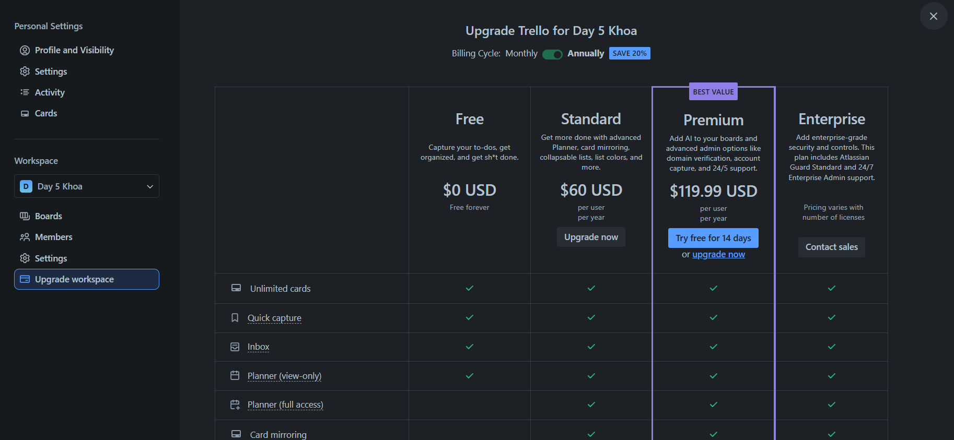
WORKSPACE IN TRELLO SYSTEM
BillingPlan
Notes:
-- Get Billing Plan
SELECT bp.Id, bp.BillingPlanName, bp.PricePerUser, bp.BillingPlanType
FROM BillingPlans bp

Slide 25
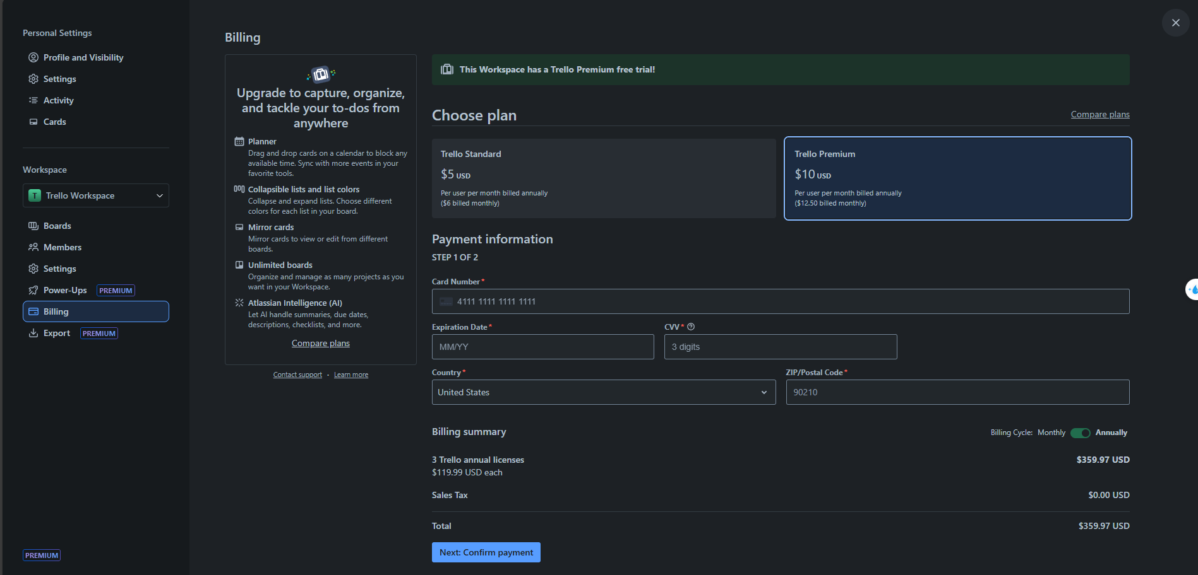
WORKSPACE IN TRELLO SYSTEM
BillingPlan
PaymentInformation

Slide 26
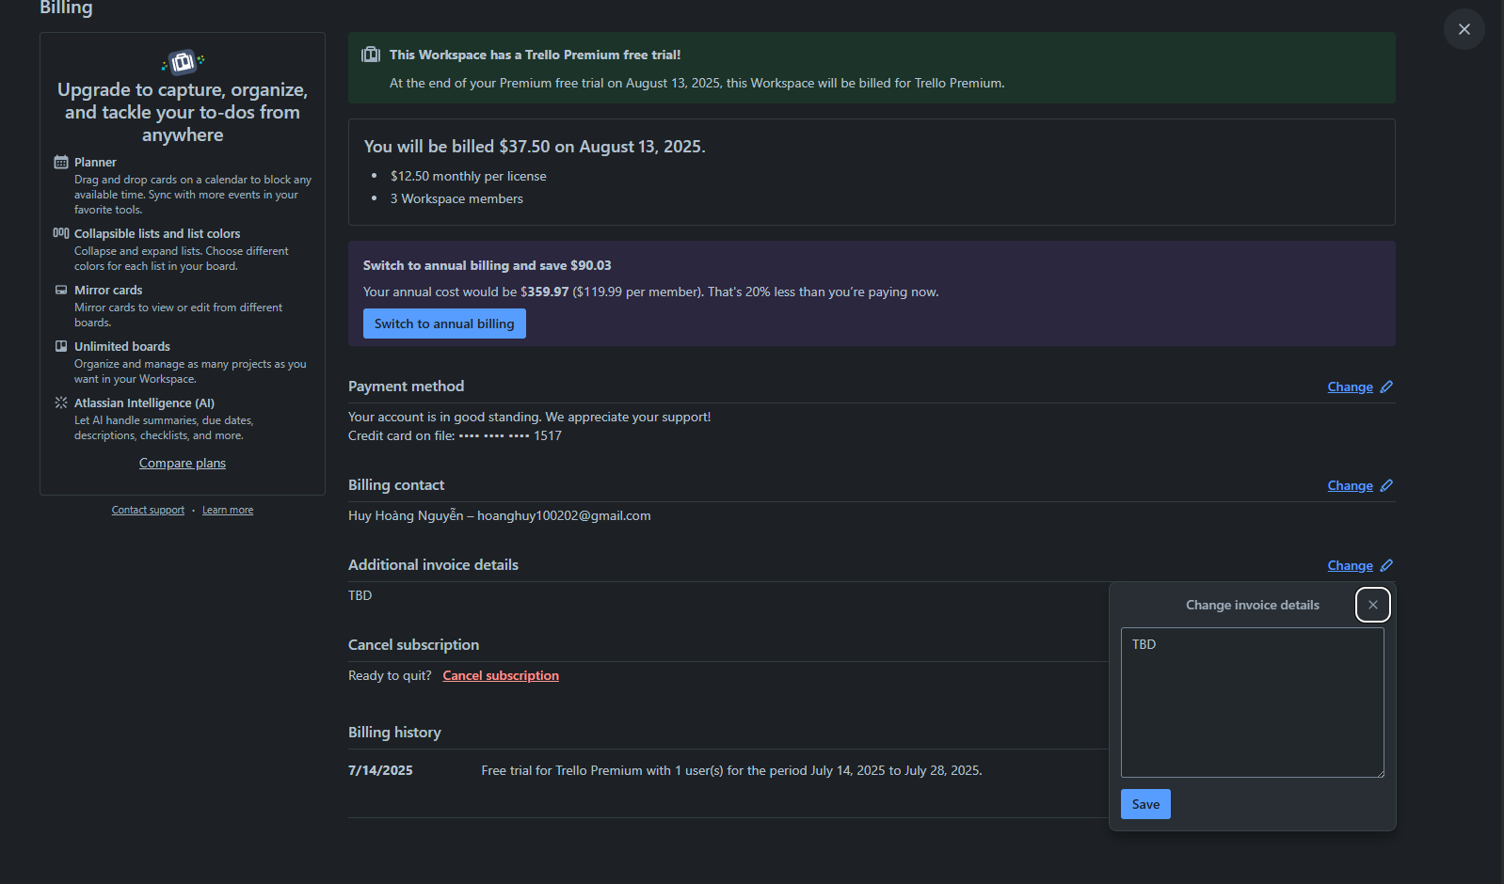
BILLING IN TRELLO SYSTEM
Billing.AdditionalInvoiceDetail

Slide 27
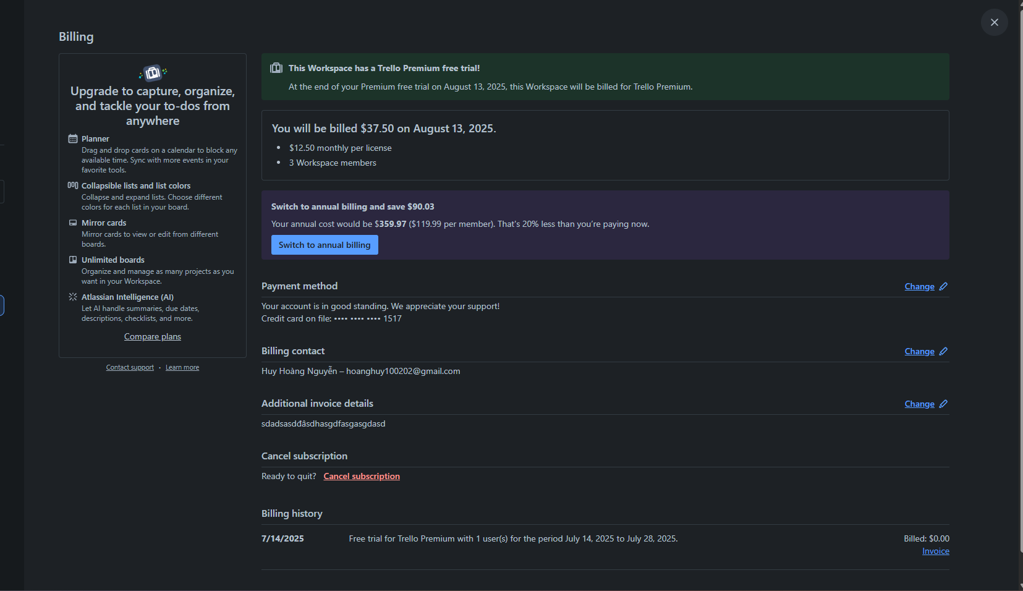
BILLING IN TRELLO SYSTEM
Subscription
Billing.AdditionalInvoiceDetail
Query from subscription
Notes:
-- Get Subscription of Billing's specific Workspace
SELECT s.Id, s.StartDate, s.EndDate, s.BillingCycle, s.MemberCountBilled, b.BillingPlanType, b.PricePerUser, b.BillingPlanName
FROM Subscriptions s
JOIN BillingPlans b ON b.Id = s.BillingPlanId
JOIN BillingContacts bc ON bc.Id = s.BillingId
JOIN Workspaces w ON w.Id = bc.WorkspaceId
WHERE w.Id = 2

Slide 28
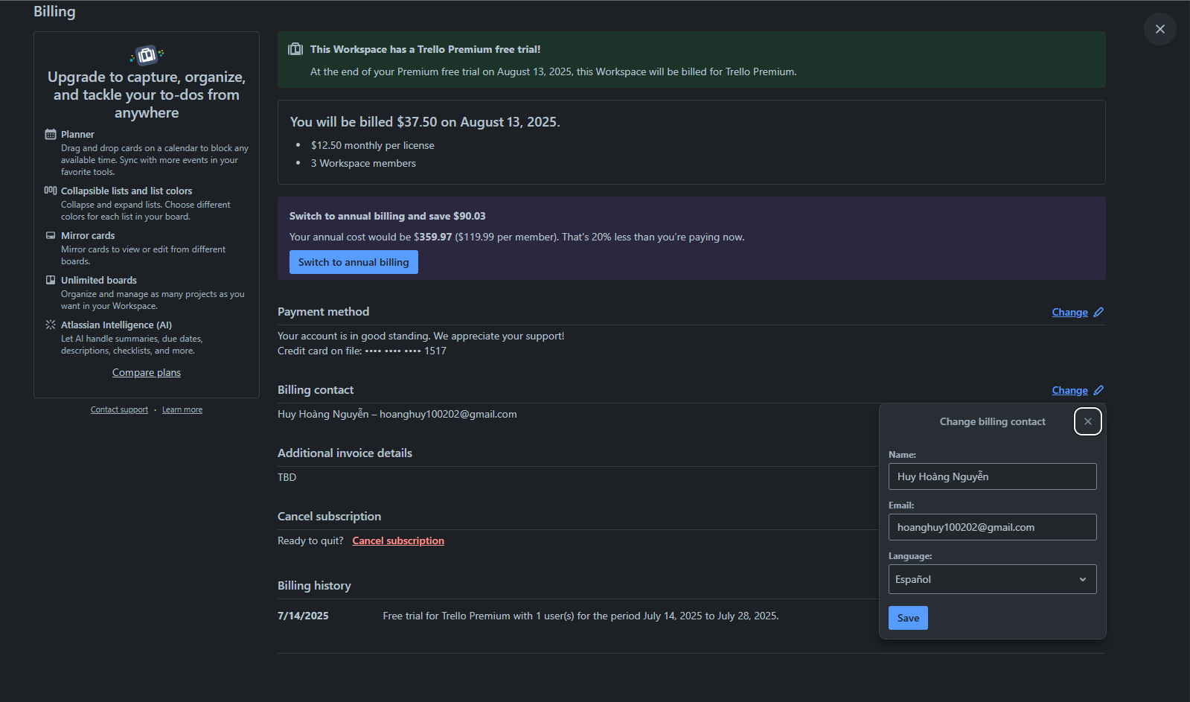
BILLING IN TRELLO SYSTEM
BillingContact
Notes:
-- Get information user of specific Workspace
SELECT bc.Id, bc.BillingContactName, bc.Email, bc.BillingContactLanguage
FROM BillingContacts bc
JOIN Subscriptions s ON bc.id = s.BillingId
JOIN Workspaces w ON w.Id = bc.WorkspaceId
WHERE w.Id = 2

Slide 29
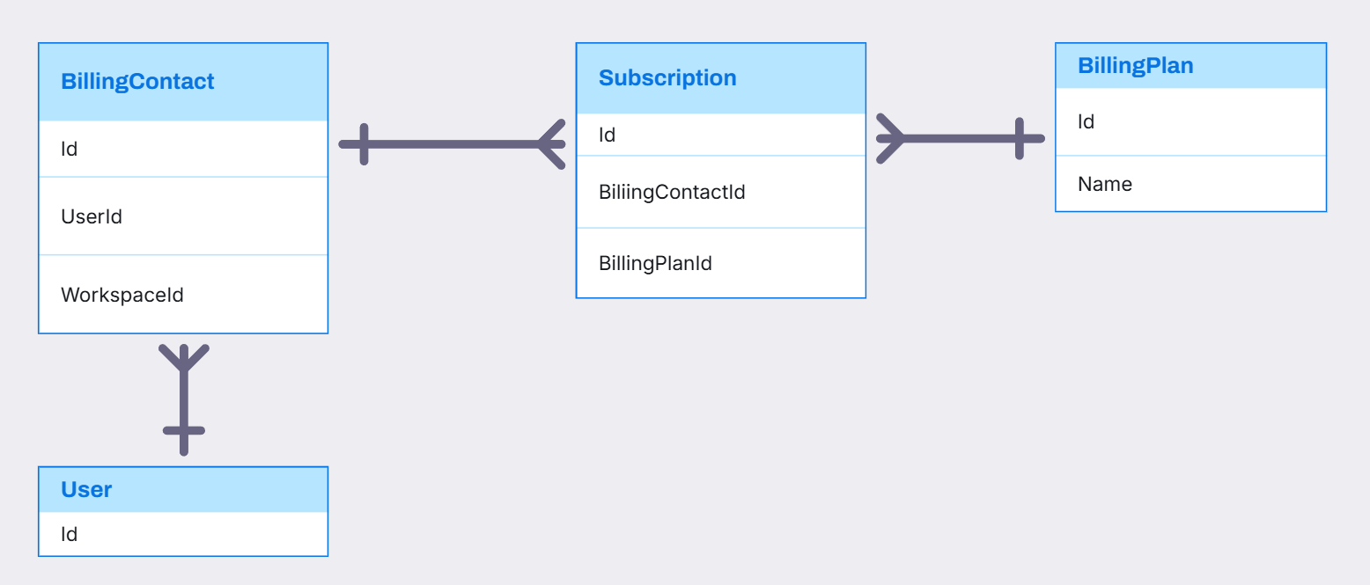
BILLINGCONTACT, BILLINGPLAN, SUBSCRIPTION RELATIONSHIP

Slide 30
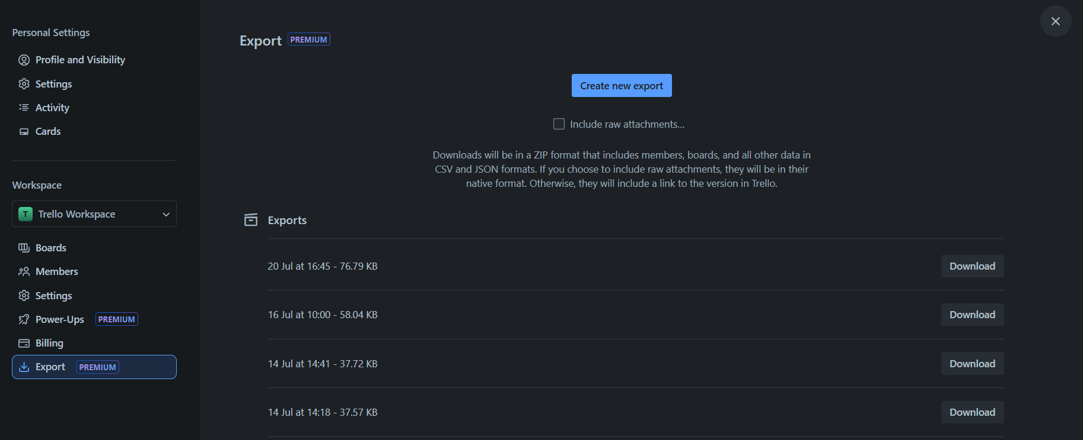
WORKSPACE IN TRELLO SYSTEM
Export
Notes:
-- List export of specific Workspace
SELECT e.Id, e.CreatedAt , e.Size
FROM Exports AS e
JOIN Workspaces w ON e.WorkspaceId = w.Id
WHERE w.Id = 1

Slide 31
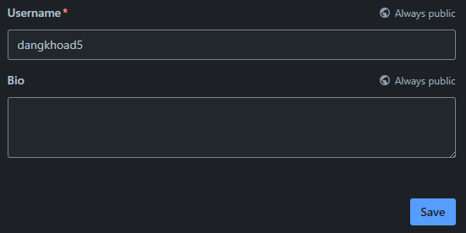
USER IN TRELLO SYSTEM
Username
UserBio

Slide 32
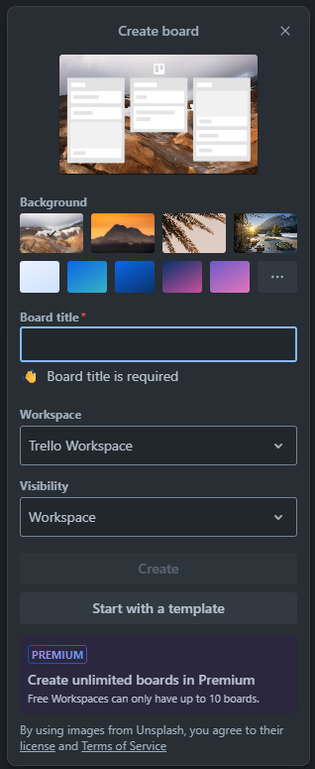
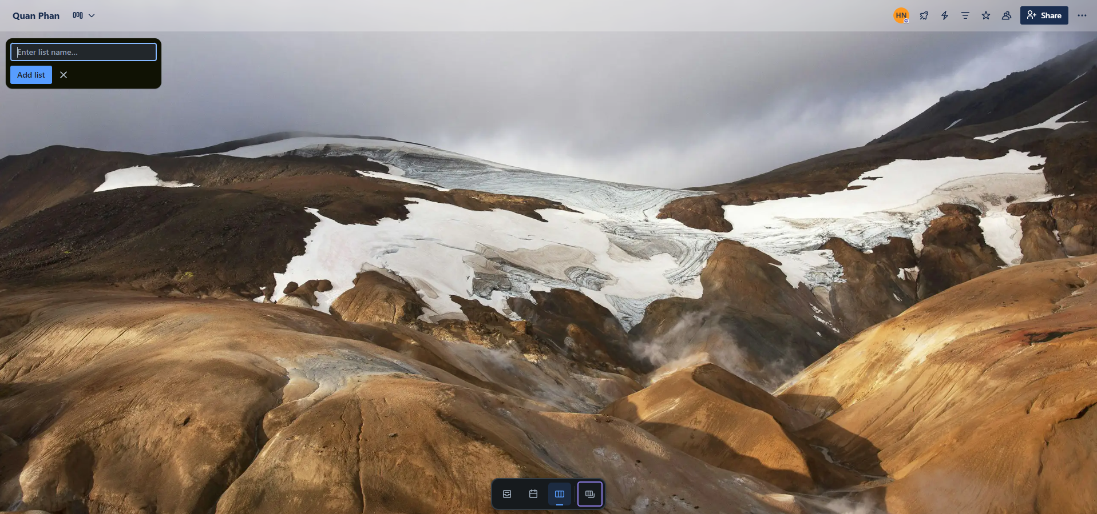
BOARD IN TRELLO SYSTEM
Stage
Board

Slide 33
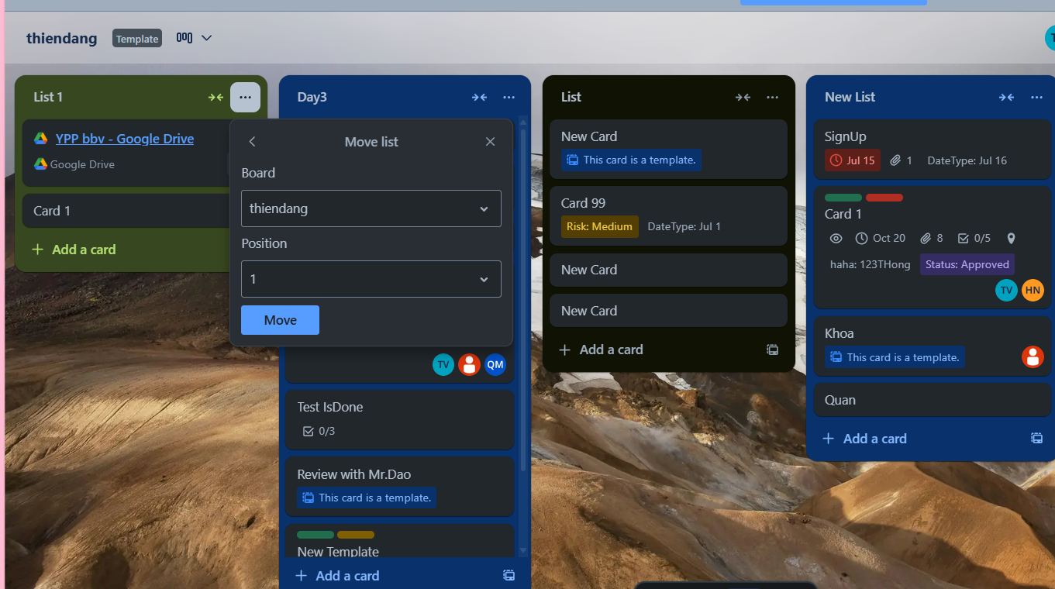
STAGE IN TRELLO SYSTEM
Stage Position
Notes:
-- Get all list Stage of board(id=1)
SELECT s.Id AS StageId, s.Title AS StageTitle, s.Position, c.ColorName
FROM Stages s
JOIN Boards b ON b.Id = s.BoardId
JOIN Colors c ON c.Id = s.ColorId
WHERE b.Id = 1
ORDER BY s.Position;

Slide 34
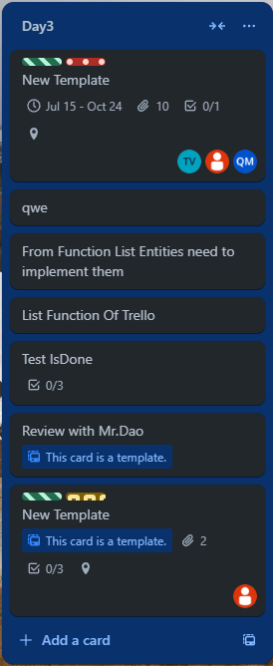
STAGE IN TRELLO SYSTEM
Stage
Card
Notes:
-- Get information card (id=1) of a stage(id=2), board(id=2)
WITH CountAttachmentCard AS (
SELECT CardId, COUNT(*) AS number_of_attachment
FROM Attachments
GROUP BY CardId
),
CountChecklistItem AS (
SELECT cl.CardId, COUNT(*) AS number_of_checklist_item
FROM CheckLists cl
JOIN CheckListItems cli ON cli.CheckListId = cl.Id
GROUP BY cl.CardId
)
SELECT c.Id, c.Title, c.[Location], c.StartDate, c.DueDate, c.Position,
ISNULL(cac.number_of_attachment, 0) AS number_of_attachment,
ISNULL(ccl.number_of_checklist_item, 0) AS number_of_checklist_item,
col.Icon,
col.Name
FROM Cards c
LEFT JOIN CountAttachmentCard cac ON cac.CardId = c.Id
LEFT JOIN CountChecklistItem ccl ON ccl.CardId = c.Id
JOIN Stages s ON s.Id = c.StageId
JOIN Boards b ON b.Id = s.BoardId
JOIN CardLabels cl ON cl.CardId = c.Id
JOIN Labels l ON l.Id = cl.LabelId
JOIN Colors col ON col.Id = l.ColorId
WHERE c.Id =219 AND s.Id = 2 AND b.Id = 2;

Slide 35
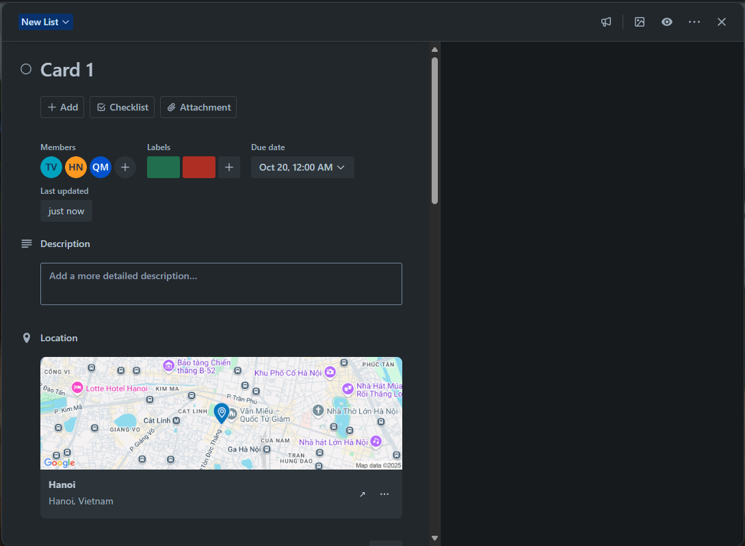
CARDS IN TRELLO SYSTEM
Member Card
CardDate
Label
CardDescription
CardLocation
Notes:
-- Get labels of card(id=1) (Slide 35)
SELECT c.Id, c.Title, col.[Name], col.Icon
FROM Labels l
JOIN CardLabels cl ON cl.LabelId = l.Id
JOIN Cards c ON c.Id = cl.CardId
JOIN Colors col ON col.Id = l.ColorId
WHERE c.Id = 1;

Slide 36
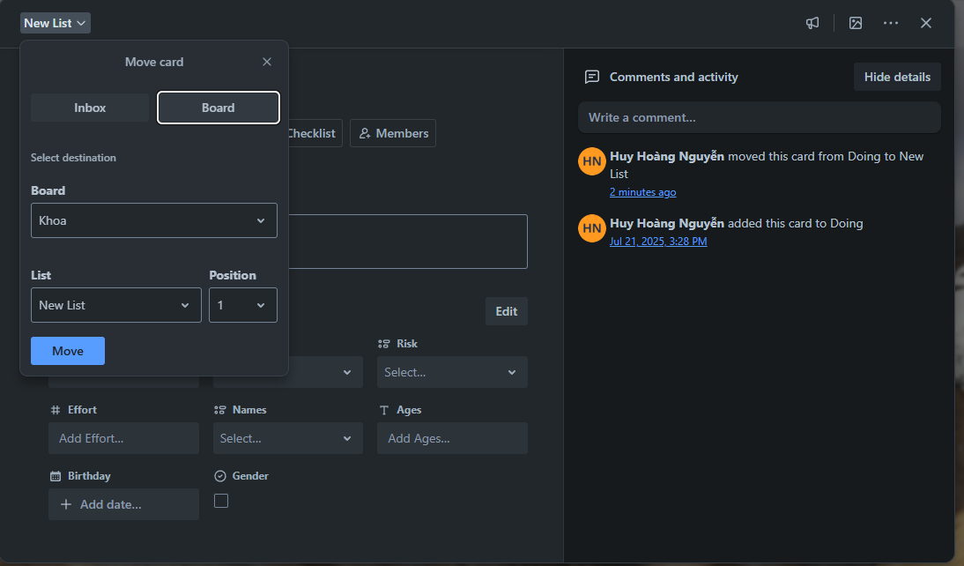
CARDS IN TRELLO SYSTEM
Card Activities
Card Position
Notes:
-- Get activities of card(id=12) (Slide 36)
SELECT a.[Description], a.CreatedAt, c.id, u.Username, u.PictureUrl
FROM Activities a
JOIN OwnerTypes ot ON ot.Id = a.OwnerTypeId
JOIN Cards c ON c.Id = a.OwnerId
JOIN Users u ON u.Id = a.UserId
WHERE ot.Value = 'Card' AND c.Id = 1
ORDER BY a.CreatedAt DESC

Slide 37
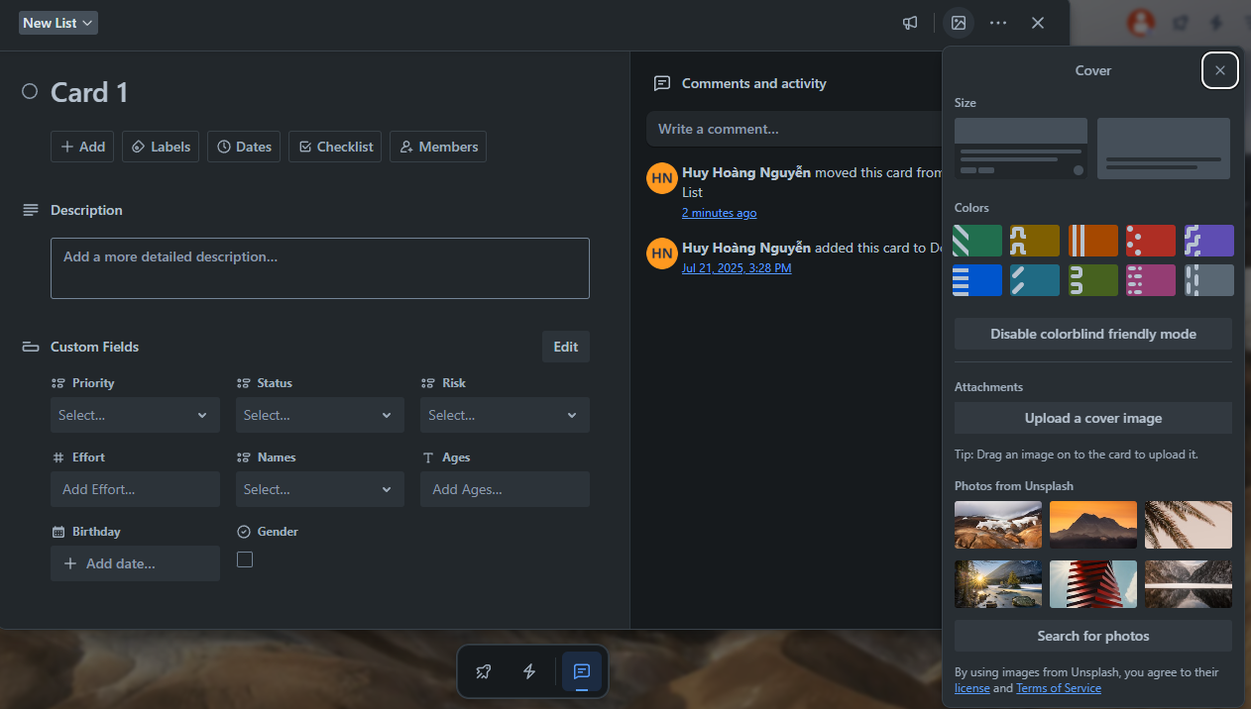
CARDS IN TRELLO SYSTEM
Color
Attachment
Card Cover
UnsplashImg
Notes:
-- Get list Photo Uplash of card(id=159)
SELECT c.CoverValue
FROM Cards c
JOIN Stages s ON s.Id = c.StageId
JOIN Boards b ON b.Id = s.BoardId
WHERE c.CoverType = 'UNSPLASH' AND b.Id = 159 AND c.Id = 1 AND c.Position = 3
Get list color with icon
SELECT Id, [Name],Icon
FROM Colors;

Slide 38
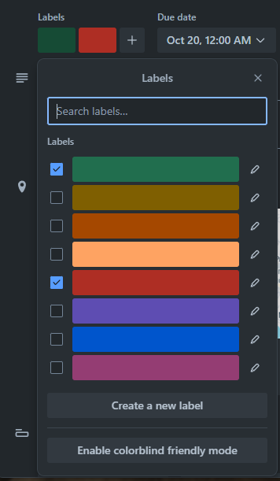
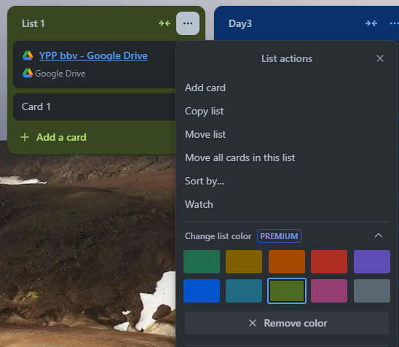
LABEL AND COLOR IN TRELLO SYSTEM
Label
Color
Notes:
-- Get label of card(id=12)
SELECT l.Title, co.[Name], co.Icon
FROM Labels l
JOIN Colors co ON co.Id = l.ColorId
JOIN CardLabels cl ON cl.LabelId = l.Id
JOIN Cards c ON c.Id = cl.CardId
WHERE c.Id = 1

Slide 39
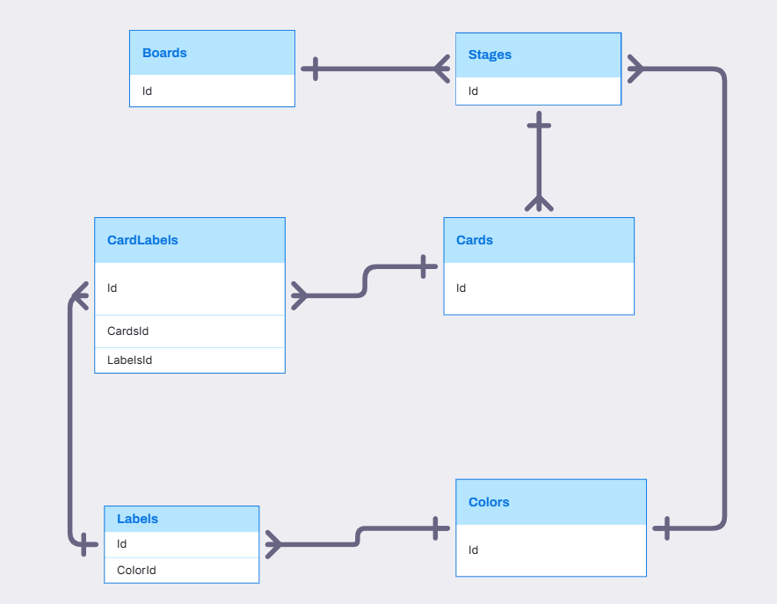
BOARD, STAGE, CARD, LABEL, COLOR RELATIONSHIP

Slide 40
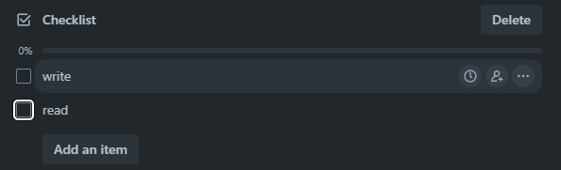
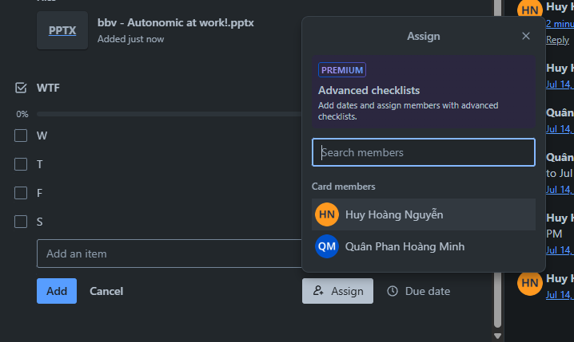
CHECKLIST IN TRELLO SYSTEM
CheckListItem
CheckList
Assign Member Into CheckListItem
Notes:
-- Get list all checklist items assigned to the user. (Slide 40)
SELECT cl.Id, cl.[Name] AS ChecklistName, cli.[Name] AS ChecklistItemName ,cli.Position, cli.[Status] , ca.Id AS CardId
FROM CheckListItems cli
JOIN CheckLists cl ON cl.Id = cli.CheckListId
JOIN Cards ca ON ca.Id = cl.CardId
JOIN Stages st ON st.Id = ca.StageId
JOIN Boards bo ON bo.Id = st.BoardId
JOIN Members me ON me.Id = cli.MemberId
JOIN Users us ON us.Id = me.UserId
WHERE ca.Id = 832

Slide 41
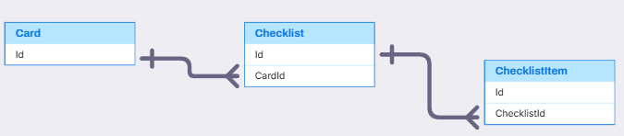
CARD, CHECKLIST, CHECKLISTITEM
Card, CheckList, CheckListItem(Quân)
,
,

Slide 42
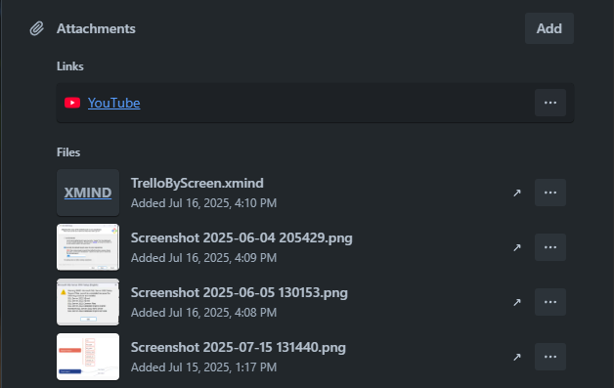
ATTACHMENT IN TRELLO SYSTEM
Attachment
Notes:
-- Get attachments of card (id = 1)
SELECT a.[Name], a.Link ,a.UploadAt, a.IsCover
FROM Attachments a
JOIN Cards c ON c.Id = a.CardId
WHERE c.Id = 50
ORDER BY UploadAt DESC

Slide 43
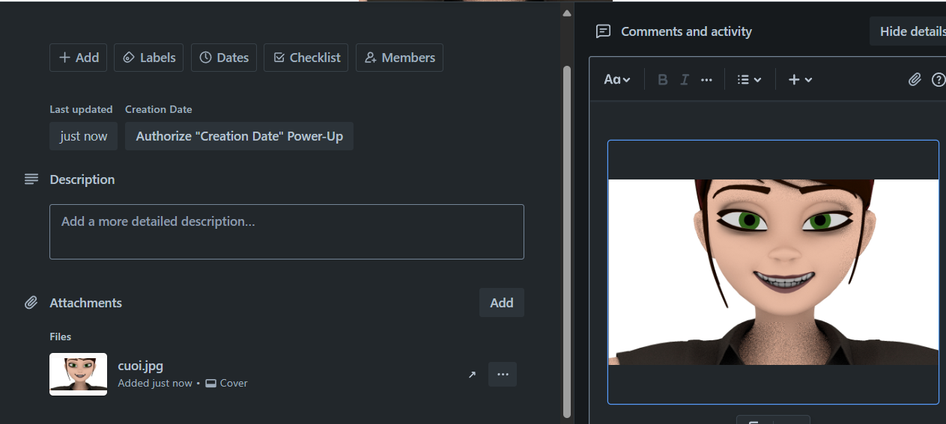
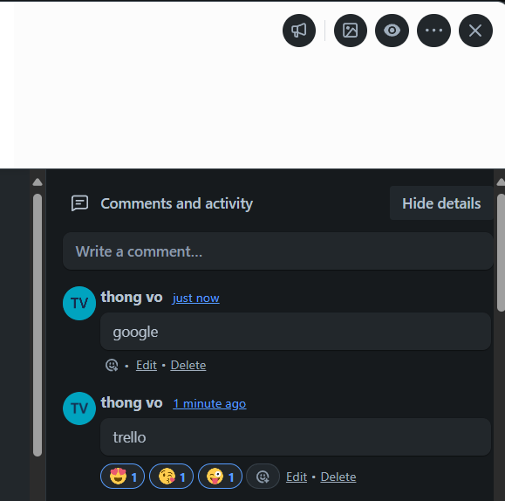
COMMENT IN TRELLO SYSTEM
Atachment
Comment
Notes:
-- Get comment of card (id = 1)
SELECT c.CardId, ca.Title AS CardTitle, c.Content, c.CreatedAt, c.Id AS CommentId, u.Username, u.PictureUrl
FROM Comments c
JOIN Cards ca ON ca.Id = c.CardId
JOIN Stages s ON s.Id = ca.StageId
JOIN Boards b ON b.Id = s.BoardId
JOIN Users u ON u.Id = c.CreatedBy
WHERE ca.Id = 1 AND s.Id = 159 AND b.Id = 159
-- Get reaction of comment's card (id = 201)
SELECT r.Id, r.Icon, COUNT(*) AS NumberReaction
FROM Reactions r
JOIN CommentReactions cr ON cr.ReactionId = r.Id
JOIN Comments c ON c.Id = cr.CommentId
WHERE c.Id = 104
GROUP BY r.Id, r.Icon;

Slide 44
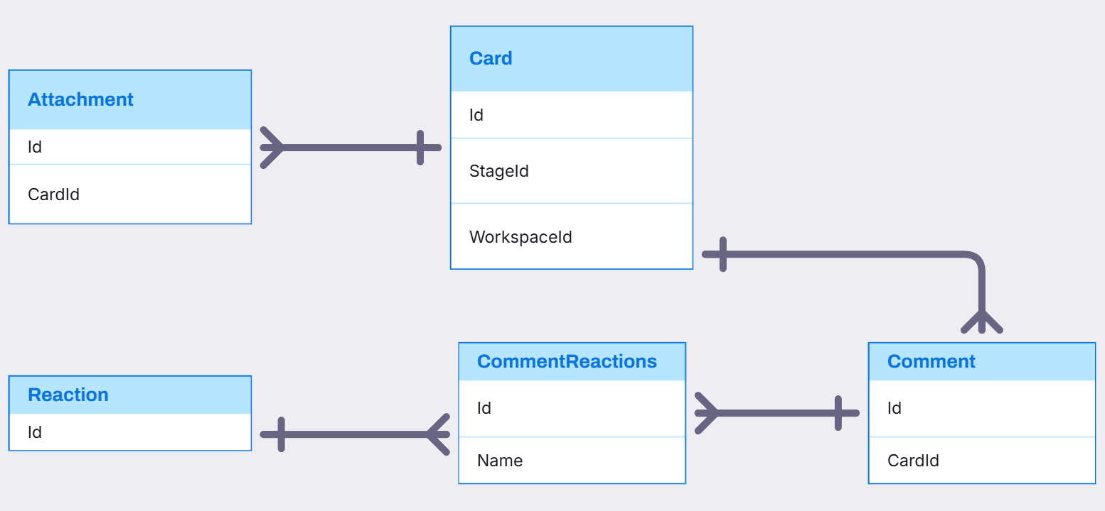
CARD, ATTACHMENT, COMMENT, REACTION RELATIONSHIP

Slide 45
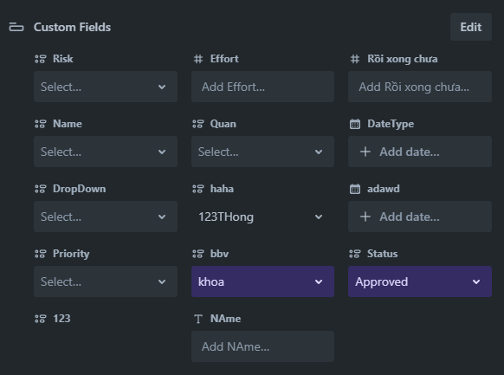

CARDS IN TRELLO SYSTEM
FieldItem
CustomField
FieldValue
FieldItem
Notes:
-- Select all Custom Field of board
SELECT cf.Id, cf.title, cf.DataTypeId
FROM CustomFields cf
WHERE cf.BoardId = 1
-- Select all Custom Field of board with value
SELECT cf.Id, cf.title, cf.DataTypeId, fv.FieldValue, fi.FieldItemValue
FROM CustomFields cf
JOIN FieldValues fv ON fv.CustomFieldId = cf.Id
LEFT JOIN FieldItems fi ON fi.Id= TRY_CAST(fv.FieldValue AS INT) AND cf.DataTypeId = 1
WHERE cf.BoardId = 1
-- Select all option of 1 Custom Field (=dropdown)
SELECT cf.Id, cf.DataTypeId, cf.Title, fi.FieldItemValue
FROM CustomFields cf
JOIN FieldItems fi ON fi.CustomFieldId= cf.Id AND cf.DataTypeId = 1
WHERE cf.BoardId = 491 AND cf.Id = 1

Slide 46

Visily
Card, CustomField, FieldValue, FieldItem(Thông)
,
,

Slide 47



STICKERS IN TRELLO SYSTEM
Click Here
Drag To Here
Sticker
Notes:
-- Get list sticker
SELECT s.Id, s.[Name], s.StickerUrl
FROM Stickers s
-- Get stickers of card(id=1)
SELECT s.Id, s.[Name], s.StickerUrl
FROM Stickers s
JOIN CardStickers cs ON cs.StickerId = s.Id
JOIN Cards c ON c.Id = cs.CardId
WHERE c.Id = 1

Slide 48

STICKERS IN TRELLO SYSTEM

Slide 49

HOME TAB IN TRELLO SYSTEM
Activity
TemplateCategory
Template
Notes:
-- Get list all recent card's activities in the user's card.
SELECT ca.Title , wo.[Name] AS WorkSpace , bo.[Name] AS Board, st.Title , u.Username , u.PictureUrl , ac.[Description],
DATEDIFF(DAY,ac.CreatedAt, GETDATE()) AS day_ago
FROM (SELECT UserId, OwnerTypeId, OwnerId, [Description], CreatedAt
FROM Activities
WHERE OwnerTypeId = 3) ac
JOIN Cards ca ON ca.Id = ac.OwnerId
JOIN Stages st ON st.Id = ca.StageId
JOIN Boards bo ON bo.Id = st.BoardId
JOIN Workspaces wo ON wo.Id = bo.WorkspaceId
JOIN Users u ON u.Id = ac.UserId
WHERE u.Id = 1
Order By day_ago;

Slide 50


NOTIFICATION IN TRELLO SYSTEM
Notification
Count Notification
Notes:
-- Show Activities unread notifications of the user.
SELECT u.Username, u.PictureUrl, a.[Description], a.CreatedAt
FROM Activities a
JOIN Notifications n ON a.Id = n.ActivityId
JOIN Users u ON u.Id = a.UserId
WHERE u.Id = 2 AND n.[Status] = 'UNREAD'
-- Count total number of unread notifications of the user.
SELECT COUNT(ac.UserId) AS NumberOfNotifications
FROM Notifications n
JOIN Activities ac ON ac.Id = n.ActivityId
WHERE ac.UserId = 2 AND n.[Status] = 'UNREAD';

Slide 51

ACTIVITY, NOTIFICATION RELATIONSHIP

Slide 52

COLLECTION IN TRELLO SYSTEM
Collection
Board
Notes:
-- Get list boards in collection (id = 1)
SELECT b.[Name] ,co.[Name]
FROM BoardCollections bc
JOIN Boards b ON b.Id = bc.BoardId
JOIN Collections co ON co.Id = bc.CollectionId
WHERE b.WorkspaceId = 1

Slide 53

COLLECTION, BOARD, BOARDCOLLECTION RELATIONSHIP

Slide 54

Q&A
Thank you
Intern | Trello Team

Slide 56
bbv template EN
How-to guides

Slide 57


bbv Master layouts & slide library
Insert new slide
1
Click on «New Slide»
1
2
Select layout
Choose the desired layout from the pre-programmed master layouts.
2
🡪
Or select layout from slide library

Slide 58




Transfer of existing slides into the new Master
1
2
3
4
Insert original slide
Copy slide in original presentation with Ctrl+C.
In the target presentation, select the slide after which the original slide is to be inserted.
Select in the tab «Home / Paste / Use Destination Theme».
Assign slide layout
Select the inserted slide
Select the desired layout in the tab «Home / Layout».
Adjust slide manually
Check all slide contents such as text blocks, images, etc. for position and size and manually adjust them to the new layout grid.
Check design
Independently check:
Font type, sizes and font colours
Colours of graphic elements
Text alignment
Coherence of the overall picture
Important:
When transferring existing slides, always carry out all four steps.

Slide 59


Change icon colour
Approach
Notes
Select icon
In the tab «Graphics Format» under «Graphics Styles», use «Graphics Fill» to change the colour
For some icons, the colour can be changed by using «Graphics Outline» instead of «Graphics Fill».
The colour cannot be changed if an icon is inserted as a picture. In this case, after selecting the icon, the tab «Picture Format» appears instead of «Graphics Format».
Best vector file format for icons: *.svg

Slide 60






Insert image into placeholder
Insert image from external source
Click on the image icon, select image from Sharepoint or other source
The bbv image library is here locally located: C:\Users\Public\bbv_templates\Marketing\PPT-Bibliotheken\Bilder-Bibliothek
Or: copy image from external source with Ctrl+C, select the placeholder, then paste with Ctrl+V
Adjust
Select the image
Click in the tab «Picture Format» on «Crop»
Adjust the image composition by moving the image
Resize the image by clicking and dragging the outer circles.
Click again on «Crop» to finish the adjustments

Slide 61






Insert image into mock-up screen (mobile/laptop)
Mock-up
Paste image
Copy image from external source with Ctrl+C and paste with Ctrl+V
Image mask
Adjust size & determine image area:
Place image behind image mask
Adjust image size and determine image area
Image mask
Crop image to image mask
Select image
Select image mask
Click in the tab «Shape Format / Merge Shapes» on «Intersect»
Combine image with mock-up
Place image behind mock-up
Activate image and mock-up and align both horizontally (Align Center) and vertically (Align Middle)
Group image and mock-up with Ctrl+G

Slide 62
bbv template EN
Style guide

Slide 63



Working area, guides & ruler
Working area
Depending on the slide, a single-column layout, a 2-column or 3-column layout is used.
Display the ruler and guides in the «View» tab.

Slide 64


bbv colour theme
Always OK!
Never, please!
Default text colours
Main accent
Colours for diagrams, charts, graphs etc.
Use selectively and sparingly
Never, please!
Colours for diagrams, charts, graphs etc.
Colours for diagrams, charts, graphs etc.

